Slide 1
Please use this form to complete your final project.
Fill out each slide, in this order, as this will make grading more efficient.
Replace text with what the text calls for.
For example, if you see, “Group member 1 name and student ID:”, replace this text with your name and student ID.
You can make the text boxes bigger to accommodate a longer text, but keep your text on the page and in the order requested.
Anthony Capasso #63
I studied the links between WAR and age in the MLB and I tried to test if there are other stats that we can use to measure individual and team skill of hitters.

Slide 2
Please write an abstract to your research project. This abstract should consist of the following nine sentences – no more or less.
1. Baseball is one of the largest sports in America and has invested heavily into better statistics through systems such as Statcast, and WAR has become the dominant stat among the baseball community when discussing a player’s worth.
2. As WAR has grown more and more popular, I wanted to look at WAR’s relationship with overall team success, judged by their win records and post-season performances, while also comparing it to other stats to see if they determine player success.
3.Is it possible that WAR is a great way for teams to measure team skill or are there other factors that need to be considered when looking at common trends among most successful teams.
4. This research will attempt to create a new way to understand team success, and will hopefully give us insight into what separates the best teams from the rest of the pack.
5. This research will use team WAR and amount of games won to see if a higher team WAR does truly lead to better regular season success.
6. We will next look at any possible relationship at age and WAR, since veteran presence in the clubhouse is an often underlooked aspect of team success.
7. Finally we will compare team WAR to playoff wins to see if that regular season success is able to be translated to the postseason.
8. We found that team WAR is a good way to predict regular season success, but is not helpful when trying to predict postseason success for teams.
9. One major limitation with this research was that it was limited to only the 2022 season, as I didn’t have enough time to manually calculate and include the data for total team WAR for multiple season, and didn’t have time to manually update the playoff dataset. Another limitation is that this data only accounts for position players, not pitchers, since pitchers are judged by completely different metric, their WAR calculation is much different than position players and would make it hard to analyze both in the same dataset.

Slide 3
The main dataset I used for my analysis is the Fansgraphs custom leaderboard dataset, which allows me to select which stats I wanted to include in my leaderboard and eventually cut this down to stats I used in my analysis and turned that into my Fangraphs Leaderboard dataset. (https://www.fangraphs.com/leaders.aspx?pos=all&stats=bat&lg=all&qual=y&type=8&season=2022&month=0&season1=2022&ind=0)
I used the mlb standings website to get my standings for my wins and playoff wins variables in my 2022_MLB_Winning_percentage data set and my Playoff_Teams dataset. (https://www.mlb.com/standings)

Slide 4
Fangraphs Leaderboard
Name Team Games Age PA SLG
A.J. Pollock : 1 PIT : 27 Min. : 6.00 Min. :20.00 Min. : 21.0 Min. :0.0500
Aaron Hicks : 1 LAA : 26 1st Qu.: 37.00 1st Qu.:25.00 1st Qu.:110.0 1st Qu.:0.3070
Aaron Judge : 1 OAK : 26 Median : 80.00 Median :27.00 Median :269.0 Median :0.3700
Abraham Almonte : 1 MIN : 24 Mean : 81.57 Mean :27.78 Mean :296.8 Mean :0.3607
Abraham Toro : 1 CIN : 23 3rd Qu.:125.00 3rd Qu.:30.00 3rd Qu.:467.5 3rd Qu.:0.4230
Adalberto Mondesi: 1 SFG : 23 Max. :162.00 Max. :42.00 Max. :724.0 Max. :0.7270
(Other) :605 (Other):462
play_WAR Clutch PA (Plate Appearance): How many times a player has taken an at-bat.
Min. :-1.6000 Min. :-2.76000
1st Qu.:-0.2000 1st Qu.:-0.35000 SLG (Slugging Percentage): Average number of bases per at-bat,
Median : 0.4000 Median :-0.05000 calculated by Total bases/PA.
Mean : 0.9411 Mean :-0.04347
3rd Qu.: 1.5500 3rd Qu.: 0.24500
Max. :11.4000 Max. : 2.46000
play_WAR (Wins Above Replacement): The amount of WAR each player has accumulated in the 2022 season, WAR attempts to estimate a player’s total value relative to a theoretical, league-average player. WAR at its core takes batting, base running, and fielding runs above average, adjusts for position and league, and then divides by Runs per Win for 2022.
WAR = (Batting Runs + Base Running Runs + Fielding Runs + Positional Adjustment + League Adjustment +Replacement Runs) / (Runs Per Win)
Clutch (Clutch Score): How well a player performs in high leverage (very important) situations compared to their average stats.

Slide 5
Codebook page 2
Team Wins WAR CLUTCH 0.5
ARI : 1 Min. : 55.00 Min. : 1.80 Min. :-5.5300 Mode :logical
ATL : 1 1st Qu.: 68.25 1st Qu.:10.60 1st Qu.:-3.0350 FALSE:14
BAL : 1 Median : 81.00 Median :19.35 Median :-0.8250 TRUE :16
BOS : 1 Mean : 81.00 Mean :19.17 Mean :-0.8853
CHC : 1 3rd Qu.: 91.50 3rd Qu.:25.60 3rd Qu.: 1.1750
CHW : 1 Max. :111.00 Max. :38.60 Max. : 7.6100
(Other):24
Wins: The number of wins each team had during the regular season
WAR: The combined total WAR of each team, calculated by getting the sum of WAR from each player on the team.
CLUTCH: The combined total Clutch of each team, calculated by getting the sum of Clutch from each player on the team.
0.5: Whether the team had an above .500 winning percentage (aka a winning record).

Slide 6
Codebook page 3
TEAM WAR CLUTCH WINS
ATL :1 Min. :22.90 Min. :-4.2100 Min. : 0.000
CLE :1 1st Qu.:24.07 1st Qu.:-3.0450 1st Qu.: 1.000
HOU :1 Median :26.60 Median :-1.7400 Median : 2.500
LAD :1 Mean :29.07 Mean :-0.4675 Mean : 3.875
NYY :1 3rd Qu.:33.60 3rd Qu.: 0.8200 3rd Qu.: 5.250
PHI :1 Max. :38.60 Max. : 7.6100 Max. :11.000
(Other):2
WAR: Combined team WAR of each playoff team
CLUTCH: Combined team Clutch of each playoff team
Wins: Number of games each team won in the 2022 postseason.

Slide 7
Research Question (1 of 3)
1 sentence: Does higher team WAR translate to more wins?
1 sentence: If a higher team WAR translates to more wins than we can predict that teams with more WAR will have more regular season wins
2 equations: Translate your hypothesis into an affirmative/alternative hypothesis, and a null hypothesis, both in equation form. For example, you might write,
H_{a} : Average number of wins for teams with higher WAR > Average number of wins for teams with lower WAR
H_{a} : Average number of wins for teams with higher WAR =< Average number of wins for teams with lower WAR
1 sentence: t-test (24), scatterplot (13), boxplot (12), histogram (15), correlation coefficients (23)
1 sentence: I expected to find that teams with higher WAR typically won more games and that is what I found from this analysis.
1 Sentence: With these tests I can reject the null hypothesis and found support that there is a positive correlation between total team WAR and team win rate.
2 sentences: What we found is that teams with higher WAR generally seemed to win more regular season games, with strong correlation and a significant difference in mean wins between teams with high WAR and teams with low WAR. This mostly lines up with what I expected, and helps solidify WAR as a valuable statistic that can be used beyond individual measurement.

Slide 8
Research Question (2 of 3)
1 sentence: Is there a relationship between WAR and Age?
1 sentence: If there is an relationship between WAR and age, we can expect that the average WAR of players older than 28 (league average) will be different than the average WAR of players 28 and under.
2 equations: Translate your hypothesis into an affirmative/alternative hypothesis, and a null hypothesis, both in equation form. For example, you might write,
H_{a} : average WAR of position players older than 28 != average WAR of position players 28 and younger
H_{a} : average WAR of position players older than 28 = average WAR of position players 28 and younger
1 sentence: f-test (27), wilcox (25), Line Diagram (11)
1 sentence: I expected to find that WAR was affected by age but there was no significant difference, at least not when split into groups of older than 28 and 28 and younger.
1 Sentence: We do not reject the null hypothesis since we did not find enough evidence to prove that there is a significant difference.
2 sentences: We found not significant difference in WAR between players older than 28 and players 28 and younger. While we did find a significant difference in variance, this can be explained by the larger sample size when older than 28, since the oldest player in this database is 42 years old and the youngest is only 20, this can also been seen in the line graph where there is significant variation post 35.

Slide 9
Research Question (3 of 3)
1 sentence: Is there a relationship between team WAR and playoff success?
1 sentence: If there is a relationship between team WAR and playoff success, we expect the teams with the highest WAR to do the best in offseason
2 equations: Translate your hypothesis into an affirmative/alternative hypothesis, and a null hypothesis, both in equation form. For example, you might write,
H_{a} : Success of teams with higher total WAR > Success of teams with lower total WAR
H_{a} : Success of teams with higher total WAR =< Success of teams with lower total WAR
1 sentence: barchart (10), regression (31), correlation matrix (22), scatterplot matrix (32)
1 sentence: I expected to find that teams with higher total WAR would perform better in the offseason, but there was actually evidence teams with higher team WAR do worse.
1 Sentence: We do not reject the null hypothesis as we have not found enough support for our alternative hypothesis.
2 sentences: While we expected to find a similar relationship between WAR and wins in the playoffs and regular season, we actually found the inverse. Having more WAR actually seems to make it less likely to win games in the playoffs and stats like CLUTCH are slightly better indicators of playoff success.

Slide 10
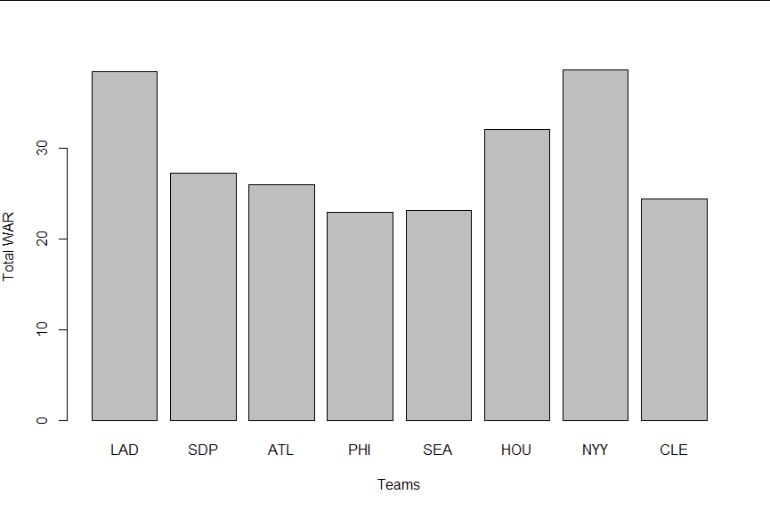
Provide a relevant Bar chart
Include a sentence (or 2) which interprets the results relevant to your research question (whether hypothesis formation or testing)
This bar chart shows the teams that made the playoffs and their total team WAR values. This chart helped me find if successful teams (PHI, HOU) and unsuccessful teams (LAD, CLE, ATL, SEA, NYY, SDP) differed in WAR.

Slide 11
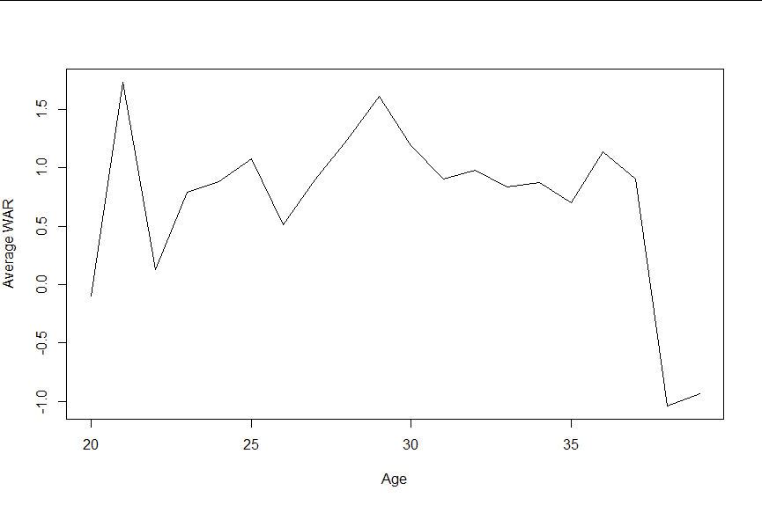
Provide a relevant Line diagram
Include a sentence (or 2) which interprets the results relevant to your research question (whether hypothesis formation or testing)
This line diagram graphs the average WAR of each age group. We can see that while there is some variation, a majority of the data is similar, with the exception of the last two years which are outliers.

Slide 12
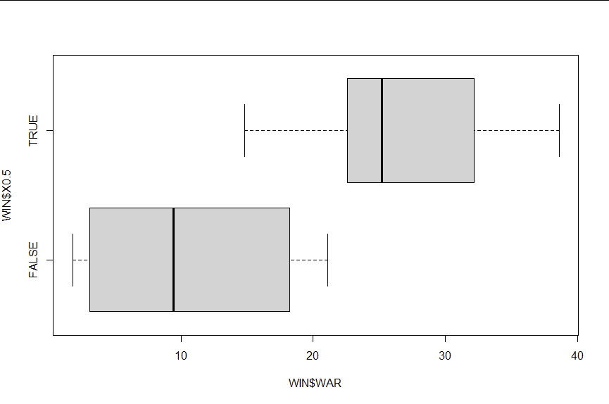
Provide a relevant Box plot
Include a sentence (or 2) which interprets the results relevant to your research question (whether hypothesis formation or testing)
For this boxplot I compared team total WAR and I grouped it by X.5 (teams who have won more than 50% of their games in 2022). This helped to test my hypothesis and found that teams with winning records have greater team WAR on average, but there are still some outliers in both categories.

Slide 13
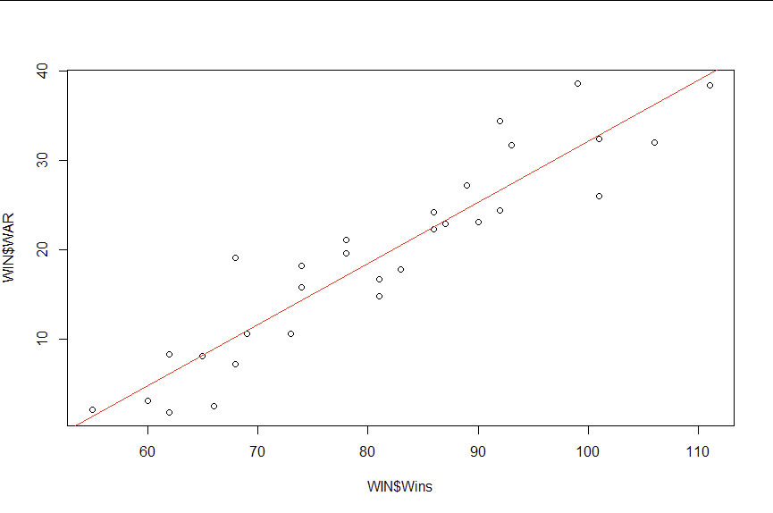
Provide a relevant Scatterplot that includes a regression line (an ABline)
Include a sentence (or 2) which interprets the results relevant to your research question (whether hypothesis formation or testing)
For this scatterplot I compared the team total war and their number of wins and used abline to create a line of best fit. We used this to test the hypothesis from our first question and found that there is a positive correlation between WAR and total wins.

Slide 14
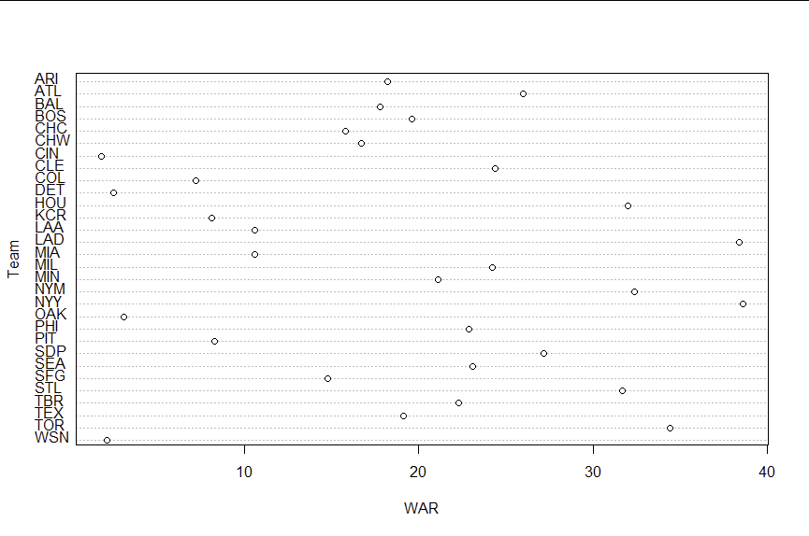
Provide a relevant Dot plot
Include a sentence (or 2) which interprets the results relevant to your research question (whether hypothesis formation or testing)
This dotchart shows the total team WAR split by team, and helps show that they are large differences in terms of team WAR.

Slide 15
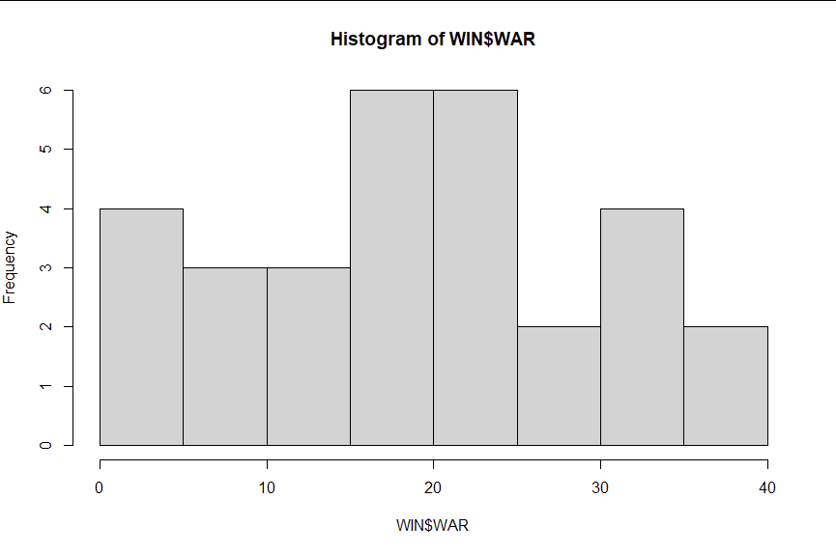
Provide a relevant Histogram
Include a sentence (or 2) which interprets the results relevant to your research question (whether hypothesis formation or testing)
For this histogram, I compared the amount of teams in each 10-WAR increment. I used this to decide what is considered high-WAR and what is considered low-WAR.

Slide 16
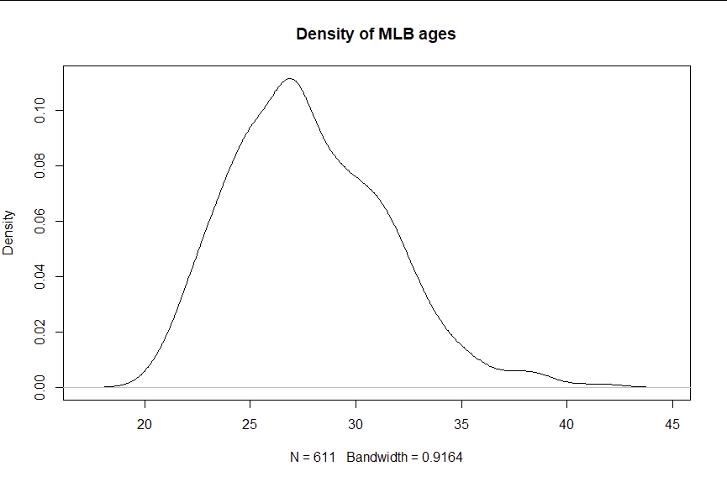
Provide a relevant Density plot
Include a sentence (or 2) which interprets the results relevant to your research question (whether hypothesis formation or testing)
For this density plot I graphed out the density of MLB ages, this helped me to confirm that 28 was roughly the age I should base my hypothesis on since it was the closest to the average age.

Slide 17
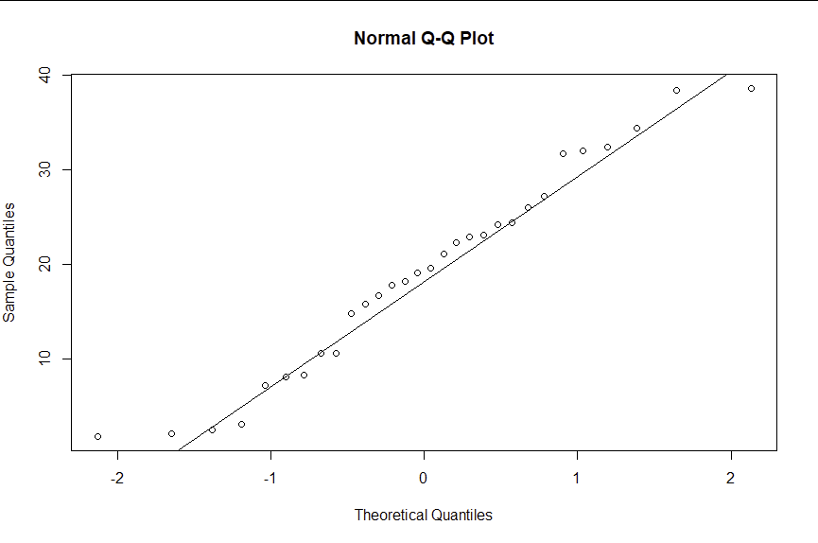
Provide a relevant QQnorm plot with a qqline
Include a sentence (or 2) which interprets the results relevant to your research question (whether hypothesis formation or testing)
I put team total WAR into a normal Q-Q plot and found that the team total WAR of the MLB is normally distributed.

Slide 18
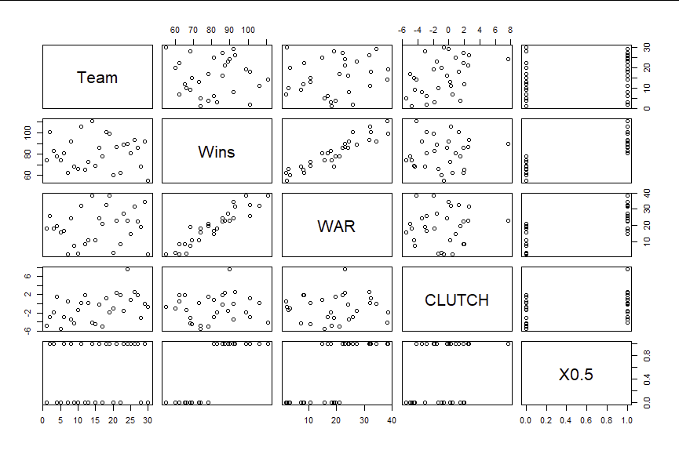
Provide a relevant Scatterplot matrix
Include a sentence (or 2) which interprets the results relevant to your research question (whether hypothesis formation or testing)
This scatterplot matrix shows the relationships between team, wins, WAR, Clutch, and having a winning record.

Slide 19
Descriptive stats (1 of 3)
Descriptive statistics such as mean, stdev, median, quartiles, min, max, range. to characterize data distributions.
Include relevant measures on this page and the next. Note that your codebook should have included summary measures – you can quote those or provide others.
Interpret the measures, and how they relate to your subject of interest (whether hypothesis formation or testing). For example, you might note that, “yearly suicide rates for teen girls during the past two decades are much more variable (higher stdev) than those of teen boys. This suggests a changing environment related to teen depression, particularly for girls.”
m20<-mean(MLB$play_WAR[MLB$Age == 20]) - Got the mean player WAR for players who are 20 years old, I repeated this for ages 20-39 and used test in the line chart (11).
> mean(MLB$Age)
[1] 27.78396 - I used this to get the average age I should use to test whether WAR is dependent on age.

Slide 20
Descriptive stats (2 of 3)
Descriptive statistics such as mean, stdev, median, quartiles, min, max, range. to characterize data distributions.
Include relevant measures on this page and the next. Note that your codebook should have included summary measures – you can quote those or provide others.
Interpret the measures, and how they relate to your subject of interest (whether hypothesis formation or testing).
> mean(WIN$WAR)
[1] 19.16667 - I used this to get the average total WAR of all MLB teams
> max(MLB$play_WAR)
[1] 11.4 - I used this to get the highest WAR for every player in the dataset.
> min(MLB$play_WAR)
[1] -1.6 - I used this to get the lowest WAR for every player in the dataset.
> mean(MLB$play_WAR[MLB$Age == 40])
[1] NaN - I used this measure to show know that I needed to stop at 39 years old for my line graph.

Slide 21
Descriptive stats (3 of 3)
Descriptive statistics such as mean, stdev, median, quartiles, min, max, range. to characterize data distributions.
Include relevant measures on this page and the next. Note that your codebook should have included summary measures – you can quote those or provide others.
Interpret the measures, and how they relate to your subject of interest (whether hypothesis formation or testing).
> median(MLB$play_WAR[MLB$Age <= 28])
[1] 0.3 - I used this to get the median WAR for players 28 and younger.
> median(MLB$play_WAR[MLB$Age > 28])
[1] 0.5 - I used this to get the median WAR for players older than 28.
> sd(MLB$play_WAR[MLB$Age > 28])
[1] 1.960866 - I used this to get the standard deviation for players older than 28
> sd(MLB$play_WAR[MLB$Age <= 28])
[1] 1.523581 - I used this to get the standard deviation for players 28 and younger

Slide 22
Correlation Matrix
> cor(cor_matrix)
Playoffs.WAR Playoffs.CLUTCH Playoffs.WINS
Playoffs.WAR 1.00000000 -0.5033400 -0.02973495
Playoffs.CLUTCH -0.50334002 1.0000000 0.12450020
Playoffs.WINS -0.02973495 0.1245002 1.00000000

Slide 23
Correlation Coefficients
> cor(WIN$WAR, WIN$Wins)
[1] 0.9308122
I found that there is a strong positive correlation between team total WAR and team wins.

Slide 24
Stat test – T-test
One tailed, two sample t-test
> t.test(WIN$Wins[WIN$WAR > 20], WIN$Wins[WIN$WAR <= 20],alternative = "greater")
Welch Two Sample t-test
data: WIN$Wins[WIN$WAR > 20] and WIN$Wins[WIN$WAR <= 20]
t = 7.5172, df = 26.728, p-value = 2.331e-08
alternative hypothesis: true difference in means is greater than 0
95 percent confidence interval:
18.3321 Inf
sample estimates:
mean of x mean of y
93.64286 69.93750
The hypothesis being tested is that average Number of wins for teams with higher WAR =< average Number of wins for teams with lower WAR
Since our p-value is below .05 we can reject this hypothesis.
We found there teams with a total WAR over 20 have a significantly greater number of wins than teams with less than or equal to 20 WAR.

Slide 25
Stat test – Mann Whitney U Wilcoxian-test
> wilcox.test(MLB$play_WAR[MLB$Age <= 28], MLB$play_WAR[MLB$Age > 28])
Wilcoxon rank sum test with continuity correction
data: MLB$play_WAR[MLB$Age <= 28] and MLB$play_WAR[MLB$Age > 28]
W = 44138, p-value = 0.907
alternative hypothesis: true location shift is not equal to 0
The hypothesis being tested is that the median WAR of players 28 and younger is different than the median WAR of players older than 28, since the p-value is greater than .05 we cannot reject the null hypothesis and we can conclude that the median WAR of players 28 and younger is not significantly different than the median WAR of players older than 28.

Slide 26
Stat test – Chi-square test
> chisq.test(table(df$MLB.Team.MLB.play_WAR....1.), p=c(1/30,1/30,1/30,1/30,1/30,1/30,1/30,1/30,1/30,1/30,1/30,1/30,1/30,1/30,1/30,1/30,1/30,1/30,1/30,1/30,1/30,1/30,1/30,1/30,1/30,1/30,1/30,1/30,1/30,1/30))
Chi-squared test for given probabilities
data: table(df$MLB.Team.MLB.play_WAR....1.)
X-squared = 30.88, df = 29, p-value = 0.3711
This tests if there is a significant difference between the number of players with above 1 WAR on each team and the expected value where they are equally distributed.
We cannot reject the null hypothesis.
There is not significant difference between team on how many players they have with above 1 WAR.

Slide 27
Stat test – f-test
> var.test(MLB$play_WAR[MLB$Age > 28], MLB$play_WAR[MLB$Age <= 28], alternative = "greater")
F test to compare two variances
data: MLB$play_WAR[MLB$Age > 28] and MLB$play_WAR[MLB$Age <= 28]
F = 1.6564, num df = 237, denom df = 372, p-value = 6.589e-06
alternative hypothesis: true ratio of variances is greater than 1
95 percent confidence interval:
1.368058 Inf
sample estimates:
ratio of variances
1.6564
This tests the hypothesis that the variance for the sample of WAR for players over the age of 28 > the variance for the sample of WAR for players 28 and under.
Since our p-value is less than .05 we can reject this hypothesis.
We found that the variance of WAR for players over the age of 28 is larger than the variance of WAR for players 28 and under.

Slide 28
Stat test – Shapiro test
> shapiro.test(WIN$WAR)
Shapiro-Wilk normality test
data: WIN$WAR
W = 0.96308, p-value = 0.3703
The hypothesis being tested is that the team total WAR data is normally distributed
Since our p-value is greater than .05 we cannot reject this hypothesis and therefore the team total WAR data is normally distributed across the league.
We found that team WAR data is normally distributed.

Slide 29
ANOVA
> sus <-aov(MLB$play_WAR~MLB$Team)
> summary(sus)
Df Sum Sq Mean Sq F value Pr(>F)
MLB$Team 29 240 8.276 3.125 1.42e-07 ***
Residuals 581 1539 2.649
---
Signif. codes: 0 ‘***’ 0.001 ‘**’ 0.01 ‘*’ 0.05 ‘.’ 0.1 ‘ ’ 1
The hypothesis being tested is that the mean total WAR of each team is equal.
Since our p-value is below .05 we can reject the Null hypothesis being tested.
There is a significant difference between the mean total WAR of each team.

Slide 30
Tukey’s Honest test
This test shows us that the difference in WAR massively differs between team matchups, as many of them have an extremely insignificant difference, but some matchups have a significant difference such as LAD-CIN and TOR-DET.
> TukeyHSD(sus)
Tukey multiple comparisons of means
95% family-wise confidence level
Fit: aov(formula = MLB$play_WAR ~ MLB$Team)
$`MLB$Team`
diff lwr upr p adj
ATL-ARI 0.433333333 -1.48257157 2.34923824 1.0000000
BAL-ARI -0.019047619 -1.91144360 1.87334836 1.0000000
BOS-ARI 0.113333333 -1.80257157 2.02923824 1.0000000
CHC-ARI -0.148484848 -2.01925273 1.72228304 1.0000000
CHW-ARI -0.031666667 -1.94757157 1.88423824 1.0000000
CIN-ARI -0.788405797 -2.63920557 1.06239398 0.9992376
CLE-ARI 0.658333333 -1.37654238 2.69320905 0.9999967
COL-ARI -0.506666667 -2.42257157 1.40923824 1.0000000
DET-ARI -0.735087719 -2.67664503 1.20646959 0.9999145
HOU-ARI 0.817543860 -1.12401345 2.75910117 0.9993784
KCR-ARI -0.416666667 -2.38633485 1.55300152 1.0000000
LAA-ARI -0.458974359 -2.25809080 1.34014209 1.0000000
LAD-ARI 1.533333333 -0.50154238 3.56820905 0.5145760
MIA-ARI -0.384848485 -2.25561637 1.48591940 1.0000000
MIL-ARI 0.477777778 -1.49189040 2.44744596 1.0000000
MIN-ARI 0.012500000 -1.81980453 1.84480453 1.0000000
NYM-ARI 0.753333333 -1.16257157 2.66923824 0.9998230
NYY-ARI 1.277777778 -0.69189040 3.24744596 0.8152649
OAK-ARI -0.747435897 -2.54655234 1.05168055 0.9995111
PHI-ARI 0.278333333 -1.63757157 2.19423824 1.0000000
PIT-ARI -0.559259259 -2.34342730 1.22490878 0.9999984
SDP-ARI 0.946666667 -1.12634926 3.01968260 0.9975388
SEA-ARI 0.288333333 -1.62757157 2.20423824 1.0000000
SFG-ARI -0.223188406 -2.07398818 1.62761137 1.0000000
STL-ARI 0.801754386 -1.13980292 2.74331169 0.9995616
TBR-ARI 0.195238095 -1.69715788 2.08763407 1.0000000
TEX-ARI -0.036231884 -1.88703166 1.81456789 1.0000000
TOR-ARI 1.426666667 -0.64634926 3.49968260 0.7123927
WSN-ARI -0.756140351 -2.69769766 1.18541696 0.9998525
BAL-ATL -0.452380952 -2.36828586 1.46352395 1.0000000
BOS-ATL -0.320000000 -2.25912884 1.61912884 1.0000000
CHC-ATL -0.581818182 -2.47636339 1.31272703 0.9999990
CHW-ATL -0.465000000 -2.40412884 1.47412884 1.0000000
CIN-ATL -1.221739130 -3.09656949 0.65309123 0.8083736
CLE-ATL 0.225000000 -1.83175673 2.28175673 1.0000000
COL-ATL -0.940000000 -2.87912884 0.99912884 0.9937689
DET-ATL -1.168421053 -3.13289906 0.79605695 0.9171314
HOU-ATL 0.384210526 -1.58026748 2.34868853 1.0000000
KCR-ATL -0.850000000 -2.84226550 1.14226550 0.9992164
LAA-ATL -0.892307692 -2.71613582 0.93152044 0.9928540
LAD-ATL 1.100000000 -0.95675673 3.15675673 0.9756535
MIA-ATL -0.818181818 -2.71272703 1.07636339 0.9990324
MIL-ATL 0.044444444 -1.94782105 2.03670994 1.0000000
MIN-ATL -0.420833333 -2.27740785 1.43574118 1.0000000
NYM-ATL 0.320000000 -1.61912884 2.25912884 1.0000000
NYY-ATL 0.844444444 -1.14782105 2.83670994 0.9993016
OAK-ATL -1.180769231 -3.00459736 0.64305890 0.8183192
PHI-ATL -0.155000000 -2.09412884 1.78412884 1.0000000
PIT-ATL -0.992592593 -2.80167652 0.81649133 0.9665105
SDP-ATL 0.513333333 -1.58116520 2.60783187 1.0000000
SEA-ATL -0.145000000 -2.08412884 1.79412884 1.0000000
SFG-ATL -0.656521739 -2.53135210 1.21830862 0.9999823
STL-ATL 0.368421053 -1.59605695 2.33289906 1.0000000
TBR-ATL -0.238095238 -2.15400014 1.67780967 1.0000000
TEX-ATL -0.469565217 -2.34439558 1.40526514 1.0000000
TOR-ATL 0.993333333 -1.10116520 3.08783187 0.9955294
WSN-ATL -1.189473684 -3.15395169 0.77500432 0.9008246
BOS-BAL 0.132380952 -1.78352395 2.04828586 1.0000000
CHC-BAL -0.129437229 -2.00020511 1.74133066 1.0000000
CHW-BAL -0.012619048 -1.92852395 1.90328586 1.0000000
CIN-BAL -0.769358178 -2.62015796 1.08144160 0.9995060
CLE-BAL 0.677380952 -1.35749476 2.71225667 0.9999939
COL-BAL -0.487619048 -2.40352395 1.42828586 1.0000000
DET-BAL -0.716040100 -2.65759741 1.22551721 0.9999491
HOU-BAL 0.836591479 -1.10496583 2.77814879 0.9990695
KCR-BAL -0.397619048 -2.36728723 1.57204913 1.0000000
LAA-BAL -0.439926740 -2.23904319 1.35918971 1.0000000
LAD-BAL 1.552380952 -0.48249476 3.58725667 0.4859017
MIA-BAL -0.365800866 -2.23656875 1.50496702 1.0000000
MIL-BAL 0.496825397 -1.47284279 2.46649358 1.0000000
MIN-BAL 0.031547619 -1.80075691 1.86385215 1.0000000
NYM-BAL 0.772380952 -1.14352395 2.68828586 0.9997175
NYY-BAL 1.296825397 -0.67284279 3.26649358 0.7919992
OAK-BAL -0.728388278 -2.52750472 1.07072817 0.9996944
PHI-BAL 0.297380952 -1.61852395 2.21328586 1.0000000
PIT-BAL -0.540211640 -2.32437968 1.24395640 0.9999992
SDP-BAL 0.965714286 -1.10730164 3.03873021 0.9966170
SEA-BAL 0.307380952 -1.60852395 2.22328586 1.0000000
SFG-BAL -0.204140787 -2.05494056 1.64665899 1.0000000
STL-BAL 0.820802005 -1.12075530 2.76235931 0.9993330
TBR-BAL 0.214285714 -1.67811026 2.10668169 1.0000000
TEX-BAL -0.017184265 -1.86798404 1.83361551 1.0000000
TOR-BAL 1.445714286 -0.62730164 3.51873021 0.6858922
WSN-BAL -0.737092732 -2.67865004 1.20446457 0.9999098
CHC-BOS -0.261818182 -2.15636339 1.63272703 1.0000000
CHW-BOS -0.145000000 -2.08412884 1.79412884 1.0000000
CIN-BOS -0.901739130 -2.77656949 0.97309123 0.9944606
CLE-BOS 0.545000000 -1.51175673 2.60175673 1.0000000
COL-BOS -0.620000000 -2.55912884 1.31912884 0.9999975
DET-BOS -0.848421053 -2.81289906 1.11605695 0.9990316
HOU-BOS 0.704210526 -1.26026748 2.66868853 0.9999713
KCR-BOS -0.530000000 -2.52226550 1.46226550 1.0000000
LAA-BOS -0.572307692 -2.39613582 1.25152044 0.9999983
LAD-BOS 1.420000000 -0.63675673 3.47675673 0.7061206
MIA-BOS -0.498181818 -2.39272703 1.39636339 1.0000000
MIL-BOS 0.364444444 -1.62782105 2.35670994 1.0000000
MIN-BOS -0.100833333 -1.95740785 1.75574118 1.0000000
NYM-BOS 0.640000000 -1.29912884 2.57912884 0.9999949
NYY-BOS 1.164444444 -0.82782105 3.15670994 0.9309861
OAK-BOS -0.860769231 -2.68459736 0.96305890 0.9958529
PHI-BOS 0.165000000 -1.77412884 2.10412884 1.0000000
PIT-BOS -0.672592593 -2.48167652 1.13649133 0.9999403
SDP-BOS 0.833333333 -1.26116520 2.92783187 0.9997789
SEA-BOS 0.175000000 -1.76412884 2.11412884 1.0000000
SFG-BOS -0.336521739 -2.21135210 1.53830862 1.0000000
STL-BOS 0.688421053 -1.27605695 2.65289906 0.9999820
TBR-BOS 0.081904762 -1.83400014 1.99780967 1.0000000
TEX-BOS -0.149565217 -2.02439558 1.72526514 1.0000000
TOR-BOS 1.313333333 -0.78116520 3.40783187 0.8621013
WSN-BOS -0.869473684 -2.83395169 1.09500432 0.9985302
CHW-CHC 0.116818182 -1.77772703 2.01136339 1.0000000
CIN-CHC -0.639920949 -2.46860073 1.18875884 0.9999825
CLE-CHC 0.806818182 -1.20795950 2.82159587 0.9997505
COL-CHC -0.358181818 -2.25272703 1.53636339 1.0000000
DET-CHC -0.586602871 -2.50708581 1.33388007 0.9999991
HOU-CHC 0.966028708 -0.95445423 2.88651165 0.9893326
KCR-CHC -0.268181818 -2.21707963 1.68071600 1.0000000
LAA-CHC -0.310489510 -2.08684250 1.46586347 1.0000000
LAD-CHC 1.681818182 -0.33295950 3.69659587 0.2865852
MIA-CHC -0.236363636 -2.08525044 1.61252317 1.0000000
MIL-CHC 0.626262626 -1.32263519 2.57516044 0.9999972
MIN-CHC 0.160984848 -1.64897366 1.97094336 1.0000000
NYM-CHC 0.901818182 -0.99272703 2.79636339 0.9952693
NYY-CHC 1.426262626 -0.52263519 3.37516044 0.5816610
OAK-CHC -0.598951049 -2.37530403 1.17740194 0.9999920
PHI-CHC 0.426818182 -1.46772703 2.32136339 1.0000000
PIT-CHC -0.410774411 -2.17198579 1.35043697 1.0000000
SDP-CHC 1.095151515 -0.95813974 3.14844277 0.9764897
SEA-CHC 0.436818182 -1.45772703 2.33136339 1.0000000
SFG-CHC -0.074703557 -1.90338334 1.75397623 1.0000000
STL-CHC 0.950239234 -0.97024370 2.87072217 0.9915749
TBR-CHC 0.343722944 -1.52704494 2.21449083 1.0000000
TEX-CHC 0.112252964 -1.71642682 1.94093275 1.0000000
TOR-CHC 1.575151515 -0.47813974 3.62844277 0.4730038
WSN-CHC -0.607655502 -2.52813844 1.31282744 0.9999980
CIN-CHW -0.756739130 -2.63156949 1.11809123 0.9997111
CLE-CHW 0.690000000 -1.36675673 2.74675673 0.9999928
COL-CHW -0.475000000 -2.41412884 1.46412884 1.0000000
DET-CHW -0.703421053 -2.66789906 1.26105695 0.9999720
HOU-CHW 0.849210526 -1.11526748 2.81368853 0.9990160
KCR-CHW -0.385000000 -2.37726550 1.60726550 1.0000000
LAA-CHW -0.427307692 -2.25113582 1.39652044 1.0000000
LAD-CHW 1.565000000 -0.49175673 3.62175673 0.4919428
MIA-CHW -0.353181818 -2.24772703 1.54136339 1.0000000
MIL-CHW 0.509444444 -1.48282105 2.50170994 1.0000000
MIN-CHW 0.044166667 -1.81240785 1.90074118 1.0000000
NYM-CHW 0.785000000 -1.15412884 2.72412884 0.9996950
NYY-CHW 1.309444444 -0.68282105 3.30170994 0.7947986
OAK-CHW -0.715769231 -2.53959736 1.10805890 0.9998292
PHI-CHW 0.310000000 -1.62912884 2.24912884 1.0000000
PIT-CHW -0.527592593 -2.33667652 1.28149133 0.9999997
SDP-CHW 0.978333333 -1.11616520 3.07283187 0.9964716
SEA-CHW 0.320000000 -1.61912884 2.25912884 1.0000000
SFG-CHW -0.191521739 -2.06635210 1.68330862 1.0000000
STL-CHW 0.833421053 -1.13105695 2.79789906 0.9992903
TBR-CHW 0.226904762 -1.68900014 2.14280967 1.0000000
TEX-CHW -0.004565217 -1.87939558 1.87026514 1.0000000
TOR-CHW 1.458333333 -0.63616520 3.55283187 0.6891859
WSN-CHW -0.724473684 -2.68895169 1.24000432 0.9999491
CLE-CIN 1.446739130 -0.54951147 3.44298973 0.6035659
COL-CIN 0.281739130 -1.59309123 2.15656949 1.0000000
DET-CIN 0.053318078 -1.84771902 1.95435518 1.0000000
HOU-CIN 1.605949657 -0.29508744 3.50698676 0.2630409
KCR-CIN 0.371739130 -1.55799920 2.30147746 1.0000000
LAA-CIN 0.329431438 -1.42587972 2.08474260 1.0000000
LAD-CIN 2.321739130 0.32548853 4.31798973 0.0049562
MIA-CIN 0.403557312 -1.42512247 2.23223710 1.0000000
MIL-CIN 1.266183575 -0.66355476 3.19592191 0.7975488
MIN-CIN 0.800905797 -0.98840613 2.59021772 0.9982269
NYM-CIN 1.541739130 -0.33309123 3.41656949 0.3173666
NYY-CIN 2.066183575 0.13644524 3.99592191 0.0195469
OAK-CIN 0.040969900 -1.71434126 1.79628106 1.0000000
PHI-CIN 1.066739130 -0.80809123 2.94156949 0.9486651
PIT-CIN 0.229146538 -1.51083992 1.96913299 1.0000000
SDP-CIN 1.735072464 -0.30004235 3.77018728 0.2456207
SEA-CIN 1.076739130 -0.79809123 2.95156949 0.9430015
SFG-CIN 0.565217391 -1.24302958 2.37346436 0.9999985
STL-CIN 1.590160183 -0.31087692 3.49119728 0.2824416
TBR-CIN 0.983643892 -0.86715589 2.83444367 0.9775418
TEX-CIN 0.752173913 -1.05607306 2.56042088 0.9995000
TOR-CIN 2.215072464 0.17995765 4.25018728 0.0152069
WSN-CIN 0.032265446 -1.86877165 1.93330255 1.0000000
COL-CLE -1.165000000 -3.22175673 0.89175673 0.9512263
DET-CLE -1.393421053 -3.47409436 0.68725226 0.7631264
HOU-CLE 0.159210526 -1.92146278 2.23988384 1.0000000
KCR-CLE -1.075000000 -3.18192890 1.03192890 0.9869845
LAA-CLE -1.117307692 -3.06573696 0.83112158 0.9439575
LAD-CLE 0.875000000 -1.29301195 3.04301195 0.9997116
MIA-CLE -1.043181818 -3.05795950 0.97159587 0.9840943
MIL-CLE -0.180555556 -2.28748446 1.92637335 1.0000000
MIN-CLE -0.645833333 -2.62494842 1.33328175 0.9999960
NYM-CLE 0.095000000 -1.96175673 2.15175673 1.0000000
NYY-CLE 0.619444444 -1.48748446 2.72637335 0.9999996
OAK-CLE -1.405769231 -3.35419850 0.54266004 0.6135144
PHI-CLE -0.380000000 -2.43675673 1.67675673 1.0000000
PIT-CLE -1.217592593 -3.15222750 0.71704232 0.8574484
SDP-CLE 0.288333333 -1.91551596 2.49218262 1.0000000
SEA-CLE -0.370000000 -2.42675673 1.68675673 1.0000000
SFG-CLE -0.881521739 -2.87777234 1.11472886 0.9985855
STL-CLE 0.143421053 -1.93725226 2.22409436 1.0000000
TBR-CLE -0.463095238 -2.49797095 1.57178048 1.0000000
TEX-CLE -0.694565217 -2.69081582 1.30168538 0.9999845
TOR-CLE 0.768333333 -1.43551596 2.97218262 0.9999838
WSN-CLE -1.414473684 -3.49514699 0.66619963 0.7358772
DET-COL -0.228421053 -2.19289906 1.73605695 1.0000000
HOU-COL 1.324210526 -0.64026748 3.28868853 0.7514818
KCR-COL 0.090000000 -1.90226550 2.08226550 1.0000000
LAA-COL 0.047692308 -1.77613582 1.87152044 1.0000000
LAD-COL 2.040000000 -0.01675673 4.09675673 0.0553390
MIA-COL 0.121818182 -1.77272703 2.01636339 1.0000000
MIL-COL 0.984444444 -1.00782105 2.97670994 0.9917362
MIN-COL 0.519166667 -1.33740785 2.37574118 0.9999999
NYM-COL 1.260000000 -0.67912884 3.19912884 0.8128094
NYY-COL 1.784444444 -0.20782105 3.77670994 0.1631509
OAK-COL -0.240769231 -2.06459736 1.58305890 1.0000000
PHI-COL 0.785000000 -1.15412884 2.72412884 0.9996950
PIT-COL -0.052592593 -1.86167652 1.75649133 1.0000000
SDP-COL 1.453333333 -0.64116520 3.54783187 0.6961201
SEA-COL 0.795000000 -1.14412884 2.73412884 0.9996153
SFG-COL 0.283478261 -1.59135210 2.15830862 1.0000000
STL-COL 1.308421053 -0.65605695 3.27289906 0.7726604
TBR-COL 0.701904762 -1.21400014 2.61780967 0.9999555
TEX-COL 0.470434783 -1.40439558 2.34526514 1.0000000
TOR-COL 1.933333333 -0.16116520 4.02783187 0.1227053
WSN-COL -0.249473684 -2.21395169 1.71500432 1.0000000
HOU-DET 1.552631579 -0.43687263 3.54213579 0.4333178
KCR-DET 0.318421053 -1.69852589 2.33536800 1.0000000
LAA-DET 0.276113360 -1.57464384 2.12687056 1.0000000
LAD-DET 2.268421053 0.18774774 4.34909436 0.0148173
MIA-DET 0.350239234 -1.57024370 2.27072217 1.0000000
MIL-DET 1.212865497 -0.80408145 3.22981244 0.9073758
MIN-DET 0.747587719 -1.13544763 2.63062307 0.9997877
NYM-DET 1.488421053 -0.47605695 3.45289906 0.5018551
NYY-DET 2.012865497 -0.00408145 4.02981244 0.0512829
OAK-DET -0.012348178 -1.86310538 1.83840902 1.0000000
PHI-DET 1.013421053 -0.95105695 2.97789906 0.9848636
PIT-DET 0.175828460 -1.66040078 2.01205770 1.0000000
SDP-DET 1.681754386 -0.43623459 3.79974336 0.3938679
SEA-DET 1.023421053 -0.94105695 2.98789906 0.9827229
SFG-DET 0.511899314 -1.38913779 2.41293641 1.0000000
STL-DET 1.536842105 -0.45266211 3.52634632 0.4569165
TBR-DET 0.930325815 -1.01123149 2.87188312 0.9947674
TEX-DET 0.698855835 -1.20218126 2.59989294 0.9999523
TOR-DET 2.161754386 0.04376541 4.27974336 0.0384081
WSN-DET -0.021052632 -2.01055684 1.96845158 1.0000000
KCR-HOU -1.234210526 -3.25115747 0.78273642 0.8901032
LAA-HOU -1.276518219 -3.12727542 0.57423898 0.7080645
LAD-HOU 0.715789474 -1.36488384 2.79646278 0.9999878
MIA-HOU -1.202392344 -3.12287528 0.71809059 0.8639773
MIL-HOU -0.339766082 -2.35671303 1.67718086 1.0000000
[ reached getOption("max.print") -- omitted 185 rows ]

Slide 31
Regression
From this logistic regression we find that having more actually decreases your chance of having more playoff wins.
> reg_WAR <- glm(Playoffs$WINS~Playoffs$WAR)
> summary(reg)
Call:
glm(formula = Playoffs$WINS ~ Playoffs$WAR)
Deviance Residuals:
Min 1Q Median 3Q Max
-3.985 -2.760 -1.330 1.321 7.179
Coefficients:
Estimate Std. Error t value Pr(>|t|)
(Intercept) 4.4099 7.4987 0.588 0.578
Playoffs$WAR -0.0184 0.2525 -0.073 0.944
(Dispersion parameter for gaussian family taken to be 18.79587)
Null deviance: 112.88 on 7 degrees of freedom
Residual deviance: 112.78 on 6 degrees of freedom
AIC: 49.871
Number of Fisher Scoring iterations: 2
>
> exp(cbind(OR = coef(reg), confint(reg)))
Waiting for profiling to be done...
OR 2.5 % 97.5 %
(Intercept) 82.2591559 3.406349e-05 1.986458e+08
Playoffs$WAR 0.9817718 5.985684e-01 1.610302e+00

Slide 32
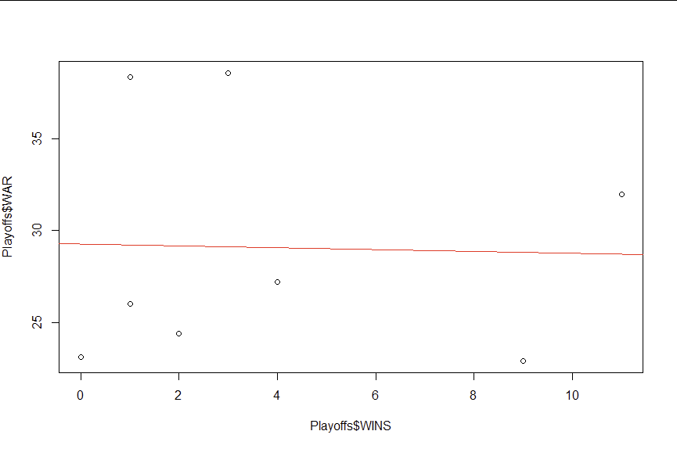
Extras
Include here any addition analyses you feel are relevant, and which you want me to see that you did.
Scatterplot with regression line comparing team playoff WAR and team playoff wins. We found that there is no significant correlation, but only a slight negative correlation.

Slide 33
Extras
Include here any addition analyses you feel are relevant, and which you want me to see that you did.

Slide 34
Extras
Include here any addition analyses you feel are relevant, and which you want me to see that you did.

Slide 35
Extras
Include here any addition analyses you feel are relevant, and which you want me to see that you did.

Slide 36
Extras
Include here any addition analyses you feel are relevant, and which you want me to see that you did.

Slide 37
Final statement
Summarizing everything you learned about your subject of interest by using the format:
How big is it?
What difference does it make?
Are you sure that’s not just dumb luck?
How big is it? - After learning about WAR and its relationship with team success, I found that WAR is an important part of baseball and a useful metric when comparing teams rather than just individuals. I also think the lack of relationship between WAR and postseason success in the 2022 season is representative of a larger baseball trend that the playoffs are a clean slate for most teams, and that perhaps teams with higher WAR who played better during the regular season crack under the expectations.
What difference does it make? - I think that WAR has a large impact on how teams perform during the regular season and is important for determine who makes it into the playoffs and what places they’ll have before the playoffs, for example every team in the playoffs had above 20 WAR. Yet it doesn’t make a big difference once teams get to the playoffs, which shows that having the best WAR doesn’t always lead to memorial outcomes for many teams and may even cause fans to feel disappointed seeing their team fall off during the playoffs.
Are you sure that’s not just dumb luck? - Using the tests laid out in this slide deck we can say with certainty that the relationship between WAR and team success is not just dumb luck, but the relationship between WAR and playoffs wins is not significantly different and could have just been dumb luck.

